Slide 1
Technical Presentation: Hall-Effect Sensor
Chase Colotta
ECE-4971

Slide 2
What is a Hall-effect sensor?
It’s a type of sensor that detects the presence and magnitude of a magnetic field using the hall effect.
They are used for measuring positioning, speed detecting, and current sensing.
It’s mainly used for timing the speed of wheels and shafts like a tachometer and anti-brake locking.

Slide 3
History of the Hall Effect
The theory of electromagnetism was published by James Clerk Maxwell in 1861
This theory was tested for the following years especially the interaction of magnets and current
In 1879, Edwin Hall discovered the hall effect eighteen years before the discovery of the electron
His findings are published with the name “On a New Action of the Magnet on Electric Currents"

Slide 4
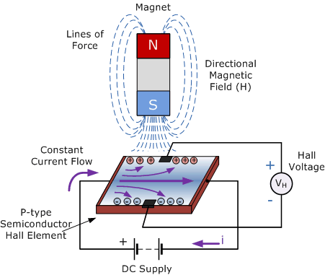
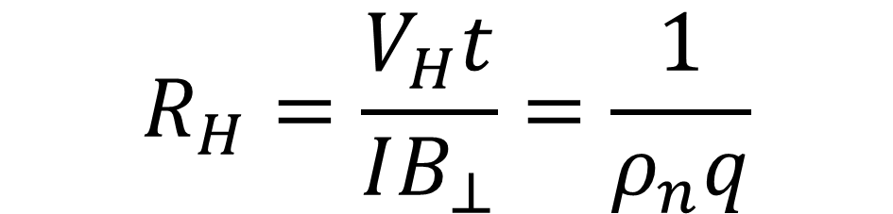
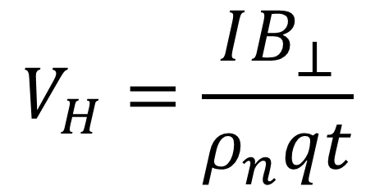
What is the Hall effect?
$$V_{H}=\frac{IB_{⊥}}{ρ_{n}qt}$$
$$R_{H}=\frac{V_{H}t}{IB_{⊥}}=\frac{1}{ρ_{n}q}$$
Notes:
Discover by Edwin Hall 1879
The Hall effect is the potential difference created in an electrical conductor when a magnetic field is introduced perpendicular to the current.
Higher magnetic field more electrons deflected making a higher voltage potential
The force that causes the electrons to shift is called Lorentz force
V_{H} is the Hall voltage across the conductive plate,
I is the current passing through the plate,
q is the magnitude of the charge of the charge carriers,
ρn is the number of charge carriers per unit volume, and
t is the thickness of the plate.
Rh is hall effect coefficient

Slide 5
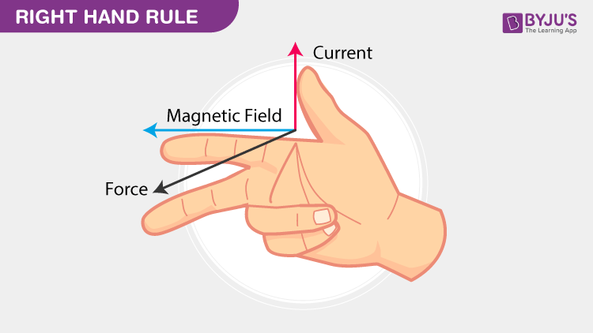

Lorentz Force
$$F=q\left(E+v×B\right)$$
F is the force acting on a particle
q is the electrical charge
v is the instantaneous velocity of the particle due to E and B
E is the external electrical field
B is the external magnetic field

Slide 6
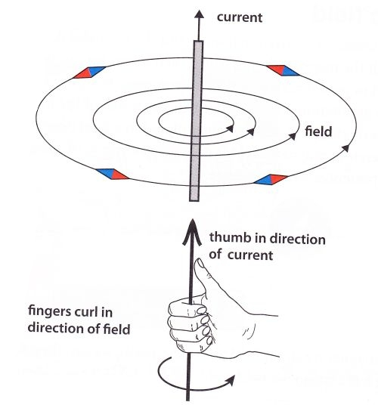
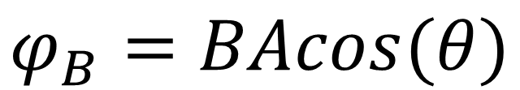
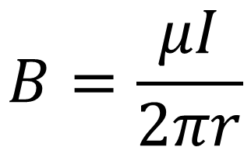
How does this work?
As Current flows a magnetic field is created
When the amps increase so does the magnetic force. Giving it a higher flux density.
$$B=\frac{μI}{2πr}$$
$$φ_{B}=BAcos(θ)$$
Notes:
Mu is the magnetic permeability
I is current
R is distance from wire
A is cross sectional area of wire
Theta angle normal to magnetic field angle

Slide 7
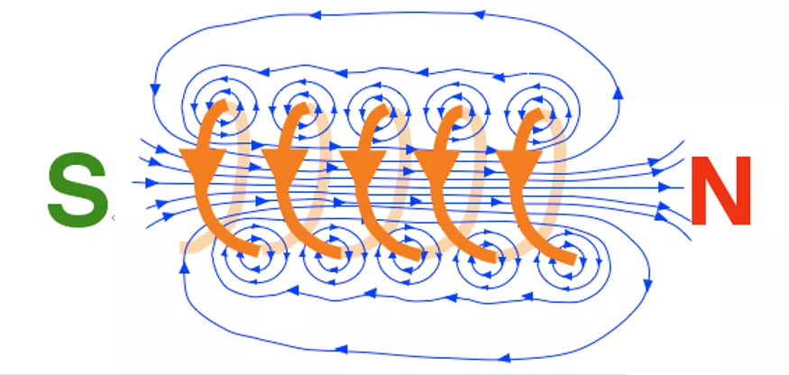
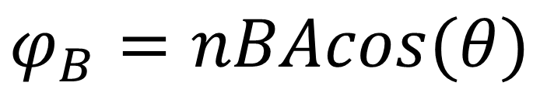
Electromagnets
When current flows in a coil it creates an electromagnet
These electromagnets can interact with permit magnetics for various effects
$$φ_{B}=nBAcos(θ)$$

Slide 8
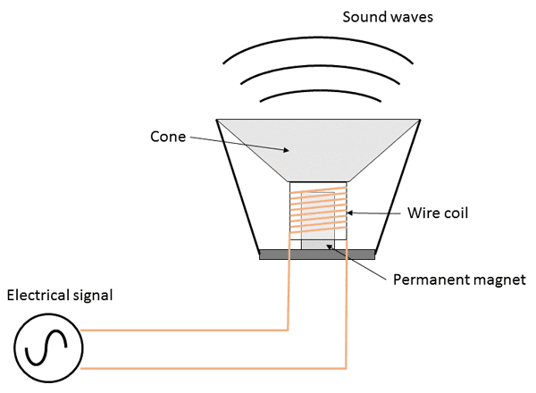
Examples of electromagnetic uses
Notes:
Brushed dc motor
The speaker works by oscillating with current changes

Slide 9
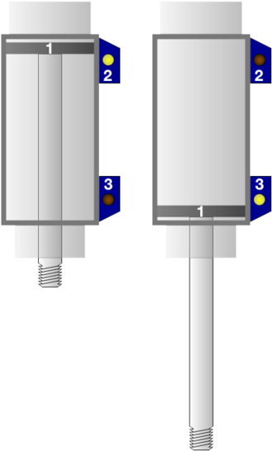
Examples of Hall Effect Senors

Slide 10
Linear Hall Sensors vs. Digital Hall Sensors
Linear
Outputs a continuous analog signal that changes with magnetic field strength.
Accurate position sensed with voltage changes.
Digital
Has a “Schmitt Trigger” circuit which changes output based on thresholds.
‘On’ and ‘Off’ uses no oscillation

Slide 11
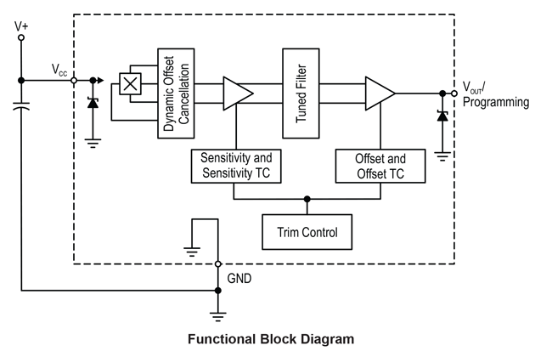
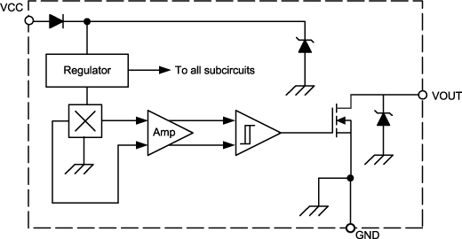
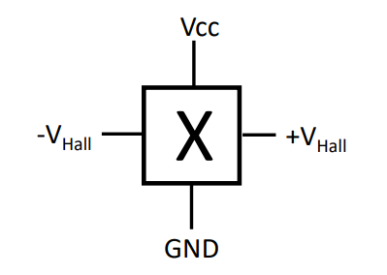
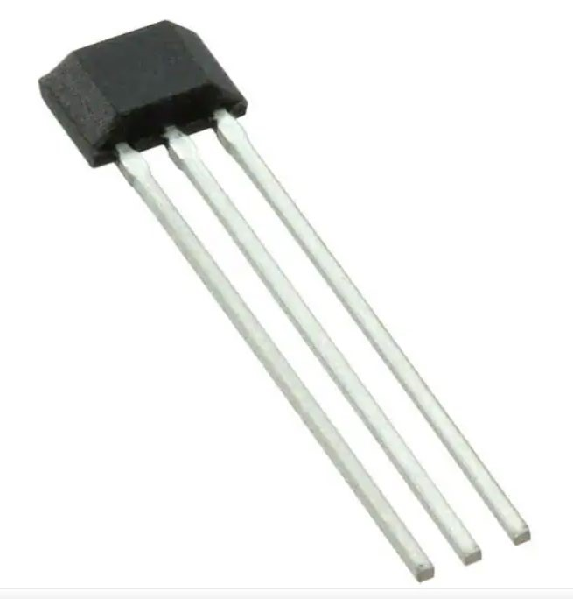
Linear Hall Sensor Circuit
Digital Hall Sensor Circuit
Notes:
Amplifiers to increase intensity of output signals
Schmitt trigger (op-amp) which gives it the on or off nature
Open collector NPN transitor there to switch to ground when magnetic flux density is higher then the on point.

Slide 12
Unipolar Sensor and Bipolar Sensor
Unipolar
Only needs a single south pole to activate and release them
Used as momentary switches
Bipolar
Requires a south pole to activate the sensor and a north pole to release them
Used as latch switches with the output

Slide 13
Hall Effect Sensors
Pros
Cons
Immune to dust, dirt, mud, and water
Is a non-contact sensor so no wear down
Needs no additional shunt resistances in the circuit
Magnetic flux from surroundings such as wires affects the measured value

Slide 14
Sources
https://en.wikipedia.org/wiki/Lorentz_force
https://en.wikipedia.org/wiki/Hall_effect
https://en.wikipedia.org/wiki/Hall_effect_sensor
https://www.icrfq.net/hall-effect-sensors/
https://www.renesas.com/us/en/support/engineer-school/brushless-dc-motor-01-overview
https://www.electronics-tutorials.ws/electromagnetism/hall-effect.html

